Slide 1
Data and Web Mining Similarity Measures
Claudio Lucchese claudio.lucchese@unive.it

Slide 2
Previously …
Similarity is a key ingredient of Recommender Systems
And of several other Web Mining Tools …
There are several similarity measures we can chose from
The best depends on the specific task
We might need to design a new measure for new task
Are the vector pairs below equally similar ?
We will see that dimensionality is an issue
1 1 1 1 1 1 1 1 1 1 1 0
1 0 0 0 0 0 0 0 0 0 0 0
vs
0 1 1 1 1 1 1 1 1 1 1 1
0 0 0 0 0 0 0 0 0 0 0 1

Slide 3
Minkowski distances
Given two N-dimensional objects X and Y, where X = [x₀, …, x_{N-1}] and Y = [y₀, …, y_{N-1}]

Slide 4
Euclidean Distance
If q=2, L₂ norm or Euclidean Distance:
It defines a metric space:
d(X,Y) >= 0 (Positivity)
d(X,Y) = d(Y,X) (Symmetry)
d(X,Y) <= d(X,Z) + d(Z,Y) (Triangular inequality)
Y
Same distance from A
X
A

Slide 5
Manhattan Distance
If q=1, L₁ norm or Manhattan or City-Block:
Y
X
A
Same distance from A

Slide 6
Chebyshev Distance
If q➝∞, L∞ norm or Chebyshev, Chessboard Distance:
Y
X
A
same distance from A

Slide 7
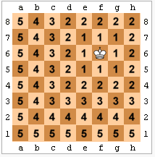
Chessboard Distance

Slide 8
Binary Vectors
Document representation
Document X = [0,1,0,1,0,1,0,1,1,1]
Document Y = [1,0,1,1,1,0,1,0,1,1]
X[i] = 1 iff the i-th term occurs in X
Contingency table:
Jaccard: X∩Y/(X∪Y) or q/(q+r+s)
Simple matching: (q+t)/p
Entries of the contingency table can be weighted as needed
X
Y

Slide 9
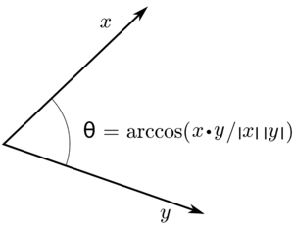
Cosine Similarity
Document representation
Document X = [0,0,0,3,0,5,0,14,7,9]
Document Y = [1,0,2,2,4,0,10,0,3,11]
X[i] is the number of times the i-th term occurs in X
Notes:
\cos(X,Y) = \frac{X\cdot Y}{\|X\|_2 \|Y\|_2}

Slide 10
Pearson Correlation
Linear dependency between variables
Does X increase when Y increases ?
Is there any correlation between income and degree ?
Standardize and multiply:

Slide 11
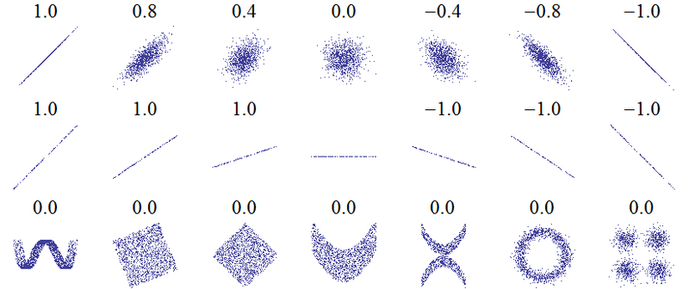
Correlation plots

Slide 12
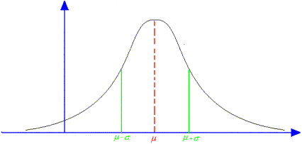
Standardization ?
Most data has Gaussian Distribution:
Average height of people
Error in measurements
[ Central Limit Theorem ]
68.2% of points is at distance at most one standard deviation from the mean
95,5% of points is at distance at most two standard deviation from the mean
Standardization is a normalization technique under Gaussian Distribution assumption
Set mean to 0, set variance to 1

Slide 13
Categorival Variables
A categorical variable assumes non comparable values
Eg.: red, yellow, green, …
Generalize binary vector measures
If X[i]=Y[j] then d(X[i],Y[i]) = 0 else d (X[i],Y[i]) = 1
Jaccard(x,y) = #variables with the same value/ #total number of variables
Transform a variable in a set of binary variables:
Eg.: red=Yes, red=No, yellow=Yes, yellow=No, …
Use the same distance measures as for binary vectors

Slide 14
Ordinal variables
It is similar to an categorical variable, but there is an implicit ordering of its values:
E.g.: Low, Medium, High
We can map them into a continuous variable
Replace the value with its rank:
Eg: Low->0, Medium->1, High->2
Map into a real valued interval such as [0,1]:
Z(x) = rank(x) / MAX_RANK
E.g.: Low -> 0.0, Medium -> 0.5, High-> 1.0
Eventually use the same techniques as for continuous variables, e.g. Euclidean distance

Slide 15
Ratio-scaled numerical variables
Numerical values spanning a non-linear scale
E.g.: number if links to a Web page
Distance measures are not significant without considering the scale
Distance is always small if close to the minimum
Distance is always large if close to the maximum
E.g.: is the difference between 1000 and 2000 in-links the same as the difference between 99000 and 100000 inlinks ?
Solutions:
Map values into a more appropriate scale
E.g.: take the log.
Consider the rank rather than the absolute value

Slide 16
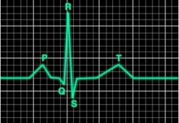
Similarity of time-series
Examples:
ECG, stocks, temperatures, stars luminosity, etc.
Euclidean Distance ?
Not robust against phase changes
2
1
A
B
0

Slide 17
Periodic Distance
The Sun exhibits high activity levels every 11 years because of sun-spots

Slide 18
Periodic Distance
Fourier Transform:
“Understands” the important frequencies in a signal, in terms of Amplitude and Phase
Amplitude_X = [100, 80, 70, 10, 0, 0, 0 ]
Amplitude_Y = [99, 80, 50, 20, 10, 0, 0]
Periodic Distance is Euclidean over amplitudes

Slide 19
The curse of dimensionality
Originally used to address optimization problems
Find the value of x that minimizes function f.
Suppose you want to find the optimum value of x ∈ {1,2,3,4,5,6,7,8,9,10}.
Try every value and check the function to optimize.
Suppose you have to variables x,y ∈ {1,2,3,4,5,6,7,8,9,10}.
You may need to try 100 cases:
x=1 & y=1, x=1 & y=2, x=1 & y=3, etc. etc.
Suppose you have n such variables, the search space grows up to 10^{n}.
Problems are considered intractable starting from n=10

Slide 20
Not only optimization problems
Anytime you have objects with a large number of attributes (variables)
In our case:
Objects are documents
Variables are term occurrence counts
Minimize similarity

Slide 21
Similarity
Suppose objects are identically independently distributed at random in the (search) space
Every dimension has values in the interval [0, 1]
Find objects at distance <0.25 from x.

Slide 22
Similarity
Suppose objects are identically independently distributed at random in the (search) space
Every dimension has values in the interval [0, 1]
Find objects at distance <0.25 from x.
1 DIMENSION
Query object x
0
1
Region of interest
Non interesting Regions
Non interesting Region
Interesting space = ½ = 50%

Slide 23
Similarity
Suppose objects are identically independently distributed at random in the (search) space
Every dimension has values in the interval [0, 1]
Find objects at distance <0.25 from x.
0,1
1,1
2 DIMENSIONS
Non Interesting Region
Query object x
Interesting Region
interesting = 4/16 = 25%
0,0
1,0

Slide 24
Similarity
Suppose objects are identically independently distributed at random in the (search) space
Every dimension has values in the interval [0, 1]
Find objects at distance <0.25 from x.
0,1,1
1,1,1
3 DIMENSIONS
0,1,0
Query object x
Non Interesting Region
Interesting Region
interesting = 8/64 = 12%
0,0,0
1,0,0

Slide 25
What does it mean ?
The region of interest halves when increasing the number of dimensions
50%, 25%, 12.5%, …
Consequently, the number of interesting objects gets smaller and smaller
For large values of n there will be no results, and for similar search radii
You need to significantly increase the search radius to get some objects, but, you’ll likely get everything !
Anything is similar or un-similar to anything else

Slide 26
Curse of Dimentionality
Everything is at the same distance.

Slide 27
How to overcome the dimensionality curse ?
Try to understand what is useful, and what is not !
Dimensionality reduction !
In most cases it is worthwhile to first reduce the number of dimensions and then run any other analysis

Slide 29
References
Data Mining Concepts and Techniques Third Edition. Jiawei Han, Micheline Kamber Jian Pei. Morgan Kaufmann/Elsevier. Third Edition.
Section 2.4 Measuring Data Similarity and Dissimilarity
[optional] Chapter 2
Notes:
Cap. 2 - “Data Mining Concepts and Technique - Third Edition”
Cap. 3 - “Data Mining Concepts and Technique - Third Edition”

